Slide 1
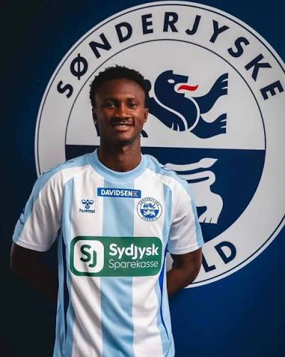
PLAYER PROFILE
LCIFOOTBALLINT / INDIVIDUAL PLAYER REPORT
Current club
SSönderjyske Fodbold
Nationality
Gambian
BUBACARR TAMBEDOU
Date of Birth
05/04/2002
Height
1.80 m
STRIKER | PRELIMINARY SCOUTING ASSESSMENT
Foot
Right-footed
Report date: 25 October 2026
Best Position
Striker
Prepared by Lamin Chatty • LCIFootballInt
Time observed :
350 minutes
SCOUTING • DATA • RECRUITMENT

Slide 2
POSITIONAL COMPETENCIES
1. RUNS IN BEHIND
2. LINK-UP & PLAYMAKING
He makes well timed, explosive runs over both short and long distances to get in behind the defensive line and receive through balls. His acceleration and pace make him a threat in attacking transitions. He is also effective in 1v1 situations, using his speed and ability to carry the ball to drive into the opposition’s penalty area.
He positions himself well to find space between the lines and receive through balls. His link-up play and combinations with teammates are very good. He can carry the ball forward and dribble past multiple opponents. His layoff passes and short, one-touch passes are accurate. He also uses his body well to protect the ball and remains composed under pressure.
3. CHANCE CREATION & FINISHING
4.TARGET MAN
His explosiveness and ability to make well-timed runs behind the defensive line allow him to consistently get into high-quality scoring positions. He shows good finishing technique, particularly in close-range situations. He is comfortable finishing with both feet and selects good shooting angles to increase his chances of scoring.
He struggles to win aerial duels despite being 1.80 m tall, which limits his effectiveness as a target man in direct long-ball situations. However, he has good acceleration and reads the ball’s trajectory well, allowing him to make runs behind the defensive line. Due to his limited physical strength, he may struggle when competing in physical duels.

Slide 3
5. DYNAMIC PRESSING
He is effective at pressing opponents and blocking passing lanes. He reads the opposition’s passing options well and uses his acceleration to close down opponents quickly, either intercepting passes or forcing them to play into less dangerous areas. However, his timing when applying pressure can be inconsistent, which sometimes reduces the effectiveness of his pressing.
SUMMARY
KEY STRENGTHS
KEY WEAKNESS
RECOMMENDATION
Movement in behind • Link-up play • Mobility • Close-range finishing • Pressing intent
Aerial duels • Physical contests • Pressing consistency
Further assessment only. The original league suggestions 2. Bundesliga / Eerste Divisie remain hypotheses until supported by comparable level evidence.
lcifootballint by Lamin Chatty
Prepared by Lamin Chatty | LCIFootballInt | Preliminary assessment — not a verified recruitment recommendation

